Slide 1

Capstone Project:
Analyzing the risk of reactivation of schools
after the Coronavirus lockdown
Avichai Itzhaki
8 May, 2020

Slide 2
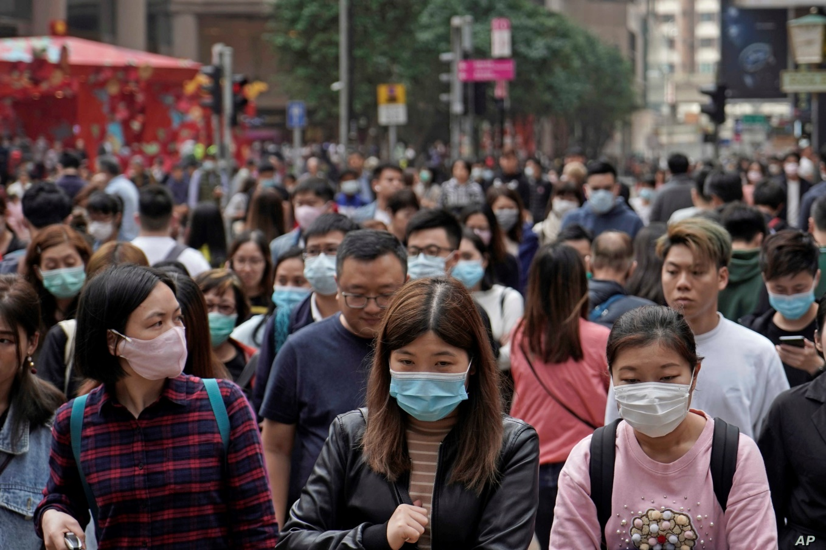
Introduction
In the recent months, the majority of the international community is facing with the enormous outbreak of the COVID-19 pandemic when one of the most common tactics among many authorities around the world for decreasing the disease's rate of expansion is closing temporarily public places and institutions in order to ensure the social distancing as much as possible.

Slide 3

Introduction
Particularly, many schools and educational institutions are closed to this method and the consequences of this action are serious and problematic – many students are staying at home and having gaps in the study material, many teachers and educators are practically unemployed and the parents of the students are struggling between managing their work and taking care of their children.
This problem is becoming more challenging when it comes to exit strategy from the virus. Although the setting of the educational system back to normal is definitely important, reckless and irresponsible process of returning of huge amount of students might enlarge the virus' spread again among the society.

Slide 4
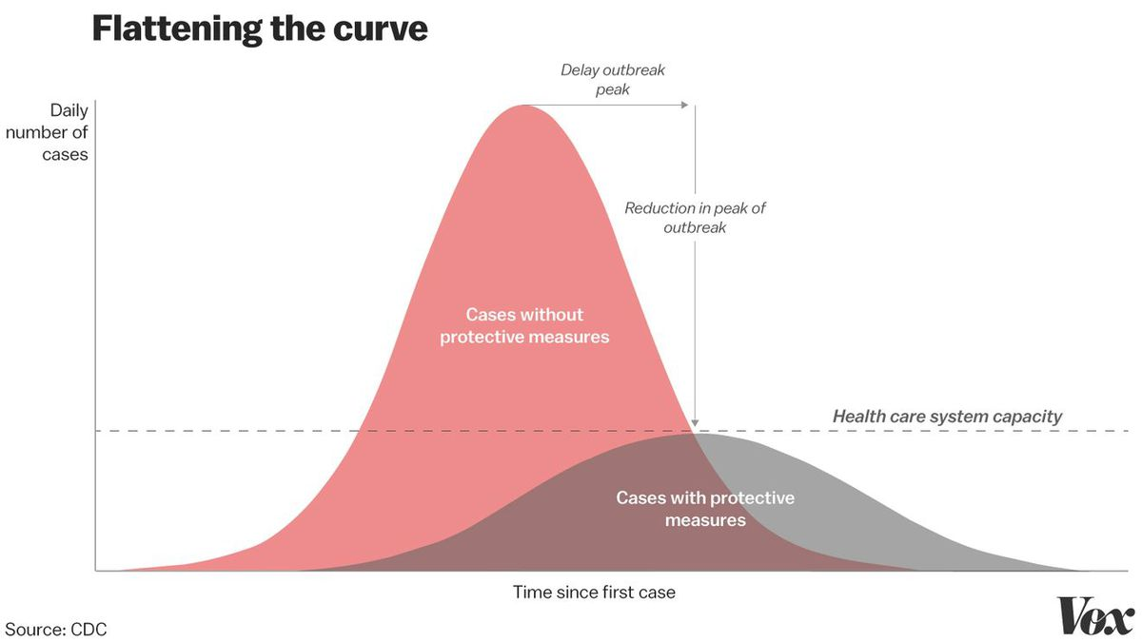
Introduction
Therefore, in order to monitor between the needs of reactivating the schools and keeping the people safe from the virus, I created a model that can help the decision makers of cities and even larger authorities to determine which schools in their jurisdiction are safer to be back in action and by methods of clustering set the basics for a more controlled for releasing the entire educational system after the lockdown.

Slide 5
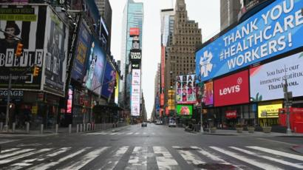
Data
For this model, I chose to focus on the data that’s related to the schools and the high schools of New York City. I chose this city since its area has one of the largest amount of known coronavirus cases in the USA and probably in the entire world.

Slide 6
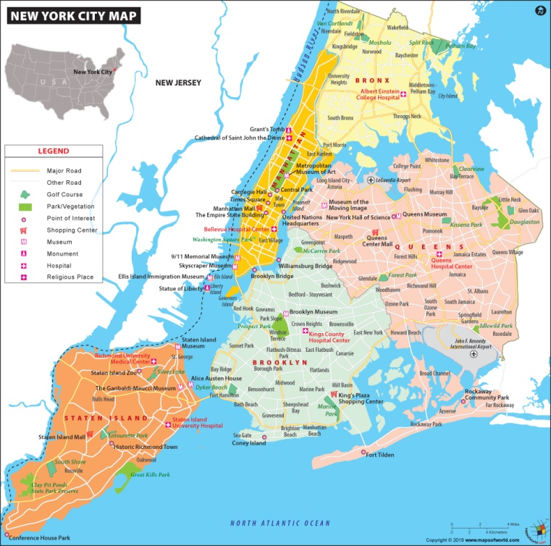
Data
I arranged the schools' data in the model's database based on the following
features:
Name of School, Neighborhood and Borough – In order to get the list of schools in NYC, I used the same database which was introduced in Assignment 3,derived from the link https://geo.nyu.edu/catalog/nyu_2451_34572 , which has the information about the lat-lon locations of each neighborhood in the city. By that data, I used the Foursquare API explore method to scroll over the neighborhoods and scrap the basic information of each school in NYC.
Latitude and Longitude of the school – lat-lon locations of each school in the database.

Slide 7
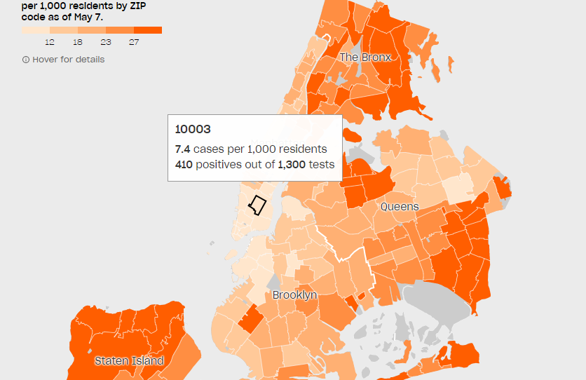
Data
The Zip Code Area of the school and its amount of Coronavirus Cases Per 1000 people – Based on the map and the CSV data which are introduced in the article: "Coronavirus in New York City, Tracking the spread of the pandemic", link: https://projects.thecity.nyc/2020_03_covid-19-tracker/. CSV files for zip code lat-lon locations and the cases for zip code – at my Github repository: https://github.com/Avichai1125/Coursera_Capstone/blob/master/uszips.csv https://github.com/Avichai1125/Coursera_Capstone/blob/master/cases_per_zip.csv

Slide 8

Data
The composition of the neighboring venues near the school – The model assumes that schools are likely to be opened at the last stages of the exit strategy, and therefore examining the types of the closest venues to the school's area is a good key for examining the risk of the virus' relapse after the school reactivation. The venues will be retrieved by the Foursquare API explore method and they will be counted and divided into main groups based on their categories, each represented by a column in the database: Restaurants, Shops and Stores, Outdoor Venues, Religious Sites, Other Indoor Venues.

Slide 9

Data
The Risk Factor – A weighted sum of the features of the venues’ composition and the cases per 1000 which represents the level of risk at re-opening the school. The weights will be determined by the importance of each factor to the risk itself when a high weight represents a higher threat.

Slide 10
Exploratory Data Analysis
For the risk factor I chose unbalanced weights for each one of the features ,varied between 0.8 and 2.5. Considerations that led for determining the weights include:
Restaurants, shops and stores had the largest weight value since their approachability to the age sections of minor schoolers and high-schoolers is the highest among the other main categories.
Religious sites are also paired with high weight due to the fact that they were proven to be a common crowding spots that unfortunately became prominent centers for the virus to spread.
Outdoor venues however, have a slightly lower than 1 value of weight according to the current perception in the scientific community that the rate of expansion of the COVID-19 virus is decreased in open spaces.
The remaining indoor venues received a neutral weight with a value of 1, due to their span of their types and the fact that a huge part of this group isn't relevant and sometimes prohibited for minor activity (such as gyms, bars and clubs).
Same weight value of 1 was also set for the cases per 1000 feature due to its high mean value compared to the other features and by that to assure its dominancy in the risk factor's essence.

Slide 11
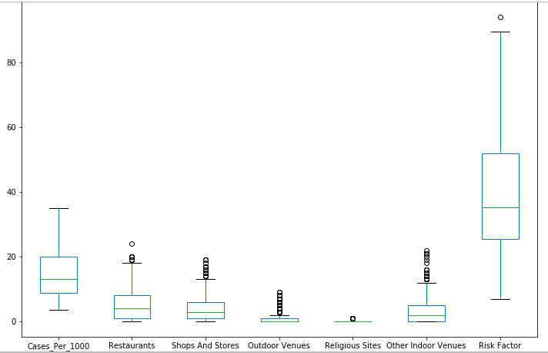
Exploratory Data Analysis
Overall distribution of the venues' categories
Despite the high amount of the outliers of the risk factor's components, the risk factor's distribution has few of them and thus seems a reliable measure for the model.

Slide 12
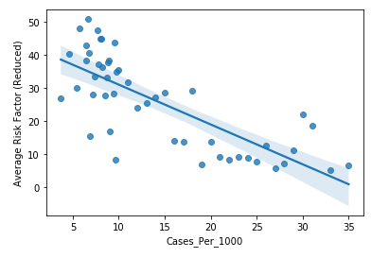
Exploratory Data Analysis
Relationship between the Cases Per 1000 feature and the risk factor:
One assumption that would likely be taken into consideration is there's a strong correlation between the incidence of coronavirus in the school's area (or particularly to our model, its zip code area), demonstrated by the Cases Per 1000, and the risk factor for the school reactivation.
In order to test this assumption, I subtracted the "Cases_Per_1000" feature's part from the risk factor and computed for each of the possible CP1000 values the average for the reduced risk factor values.
With these values I created a regression plot to examine the correlation

Slide 13
Exploratory Data Analysis
Relationship between the Cases Per 1000 feature and the risk factor:
The graph proves the assumption and it demonstrated a strong correlation between those variables, however, the correlation is surprisingly negative.
This is probably caused by the fact that the remaining reduced risk factor is based on the venues' data, and since the places with the highest CP1000 values are mostly located in the outskirts and in the poor borough of Bronx, area with lack of places of entertainment, the risk in those areas from the venues is getting lower.

Slide 14
Analyzing the Data by the Model
During the process of the data preparation it became more clearly to see that the chosen features for analyzing the schools in New York City for the model, can be divided into main groups: geographical features – latitude, longitude, borough, neighborhood and zip code and environmental features – cases per 1000, restaurants, shops and stores, outdoor venues, religious sites, and other indoor venues.
Therefore, in order to have proper insights for setting the key points of the schools' reactivation process, we need to examine the interactions between the geographical and the environmental concepts of the data's features as well as analyzing each of their influences on the risk factor.

Slide 15
Analyzing the Data by the Model
For that matter, the analysis, as it performed by the model, will have three main parts:
Analyzing the relationship between the geographical features and the risk factor: By applying the K-means algorithm over the data of the lat-lon coordinates, we will test the dependency of the risk factor based on the geographical location of the school. Since the population of New York City is divided in 5 main boroughs, we set the number of clusters as K=5 in order to have a more realistic and easy understanding results for the decision makers.
Analyzing the relationship between the environmental features and the risk factor: By applying the K-means algorithm over the environmental features we'll be able to find complex characteristics of the schools' area based on the composition of their surrounding venues. In that case, the objective is to detect special cases and phenomena that might be taken into considering in the reactivation process as well as their effects on the risk factor. Since there are 5 features for describing the venues' distribution, we set the number of clusters as K=5 for assuring that each feature for the most will have a dominant influence in one of the resulting types.

Slide 16
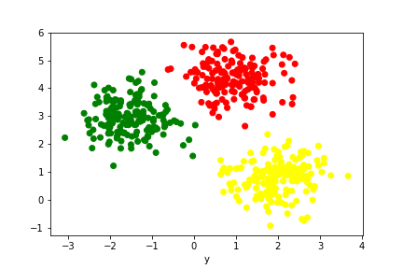
Analyzing the Data by the Model
Analyzing the connection between the environmental and the geographical features: By the knowledge that was earned in the two previous parts of the model and by using statistical methods, we will examine the correlation between the environmental and the geographical according to the two different types of labeling we offered for each school.

Slide 17
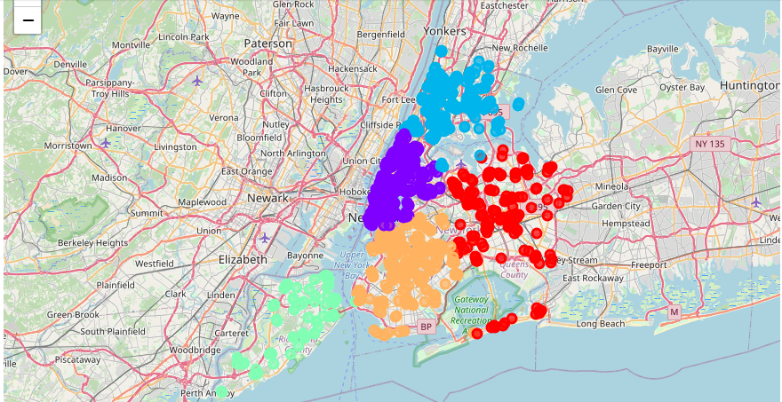
Results
Analysis of the risk factor based on geographical features (location labels)
Based on the results after applying the K-means algorithm over the geographical features of the NYC schools' data, we received 5 clusters whose geographical locations are shown below:
Legend Label 1, Label 2, Label 3, Label 4, Label 5

Slide 18
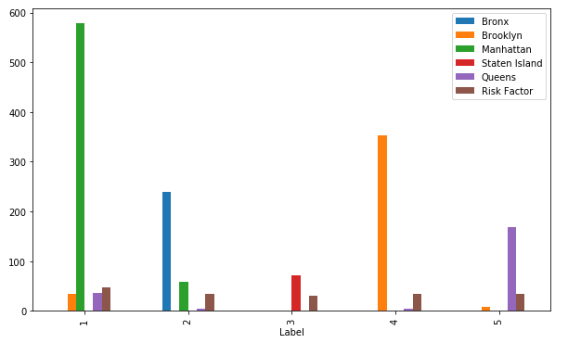
Results
The partition of the location labeled clusters over the boroughs of New York City
Same with the motive of choosing the number of the clusters, the map and the chart demonstrate the strong connection between the labels and the boroughs of NYC: Label 1 is focused on Manhattan, label 2 on Bronx, label 3 on Staten Island, label 4 on Brooklyn and label 5 on Queens.

Slide 19
Results
The highest mean value of the risk factor among the labels belongs to label 1 (~46.8815) while in other clusters the value is around 35, fact that implies about Manhattan being a very challenging place for the schools' reactivation procedure. That claim can also be confirmed by looking the venues' data of label 1 where the mean values of environmental features are significantly higher than the other labels.

Slide 20
Results
On the other hand, Staten Island is shown to be the least dangerous place for the reactivation procedure due its low risk factor value, in contrast to its high CP1000 value, proving the negative correlation we examined between this value and the risk factor.

Slide 21
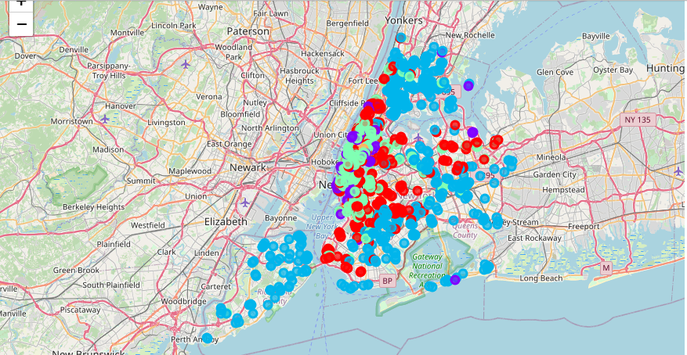
Results
Analysis of the risk factor based on environmental features (composition labels)
Based on the results after applying the K-means algorithm over the environmental features of the NYC schools' data, we received 5 clusters whose geographical locations are shown below:
Legend Label 1, Label 2, Label 3, Label 4, Label 5

Slide 22
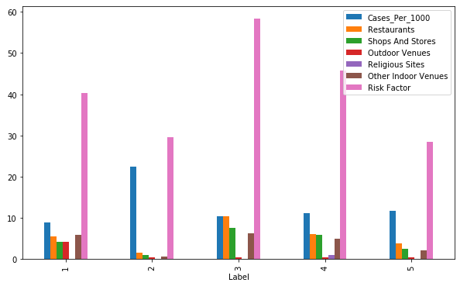
Results
The mean values of the venues' data and the risk factor for each of the clusters
By analyzing the mean values of the venues' data for each of the labels, compared to the corresponding mean value for the risk factor, we can properly define the sub groups of the NYC schools which the composition labels are referring to.

Slide 23
Results
Possible Definitions for the composition-labeled clusters:
Comp label 3 - A large cluster of schools with low CP1000 values, but with high amount of restaurants, shops and stores around them, with average risk factor of 58.3741 (the highest).
Comp label 4 - The smallest cluster among the other of schools with low CP1000 values, but with high presence of restaurants and religious sites, with average risk factor of 45.7909.
Comp label 1 - A small-medium sized cluster of schools with the lowest CP1000 values among the other labels, but with a significant presence of indoor and outdoor venues around them, with average risk factor of 40.3779.
Comp label 2 - The largest cluster of among the others of schools with very high CP1000 values and a very low presence of venues' around them, with average risk factor of 29.523.
Comp label 5 - A very large group of schools with low CP1000 values and low presence of venues around them, with average risk factor of 28.5296 (the lowest).

Slide 24
Results
The huge amount of schools with low risk values (labels 2 and 5) can enlarge the operating space and the requested time limit for the reactivation process, but the high standard deviation values of the more problematic clusters (label 3 and label 1) might be a huge obstacle for initiating the plan.

Slide 25
Results
Relationship between the location labels and the composition labels
By computing the Pearson correlation coefficient between the vectors of the location labels and the composition labels (derived from the columns of the model's dataframe), we get a value of -0.0117 , which is pretty close to 0 and therefore indicates that there is no sign of dependency between these two labeling types.
However, we can still takes notes for the relationship between them by analyzing the partition of the composition labels over the location labels (How many schools with location label of 1 have a composition label of 1 and so on…).

Slide 26
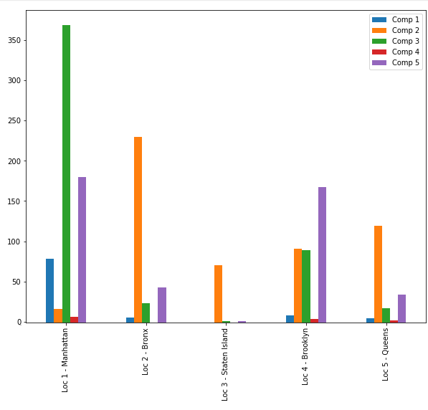
Results
The partition of the composition labels over the location labels
By looking at this chart along with the geographical span of the composition labels' clusters, it's pretty clear to see that the largest number of high risk labeled schools (labels 1, 3 and 4) are mostly located in Manhattan area and as long as the school is far away from the center of the city, its affiliation with the "safe" clusters (labels 2 and 5) is more common.

Slide 27
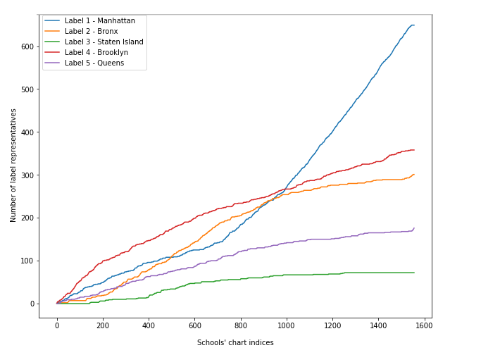
Results
Distribution of the location labels along the increasing risk factor
The chart shows that the Manhattan related cluster has a decent number of low risk schools while it also has a dominant amount of representatives at the top 600 highest risk schools in NYC.
The increase in its growth on list occurs at the same place where the other labels' schools became less common.

Slide 28
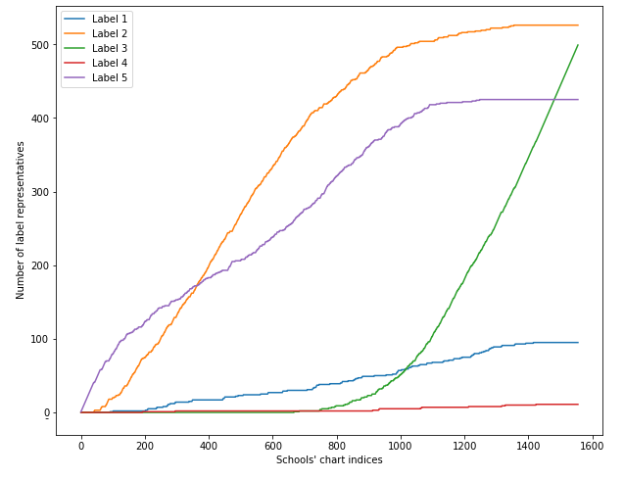
Results
Distribution of the composition labels along the increasing risk factor
The chart shows that the Manhattan related cluster has a decent number of low risk schools while it also has a dominant amount of representatives at the top 600 highest risk schools in NYC.
The increase in its growth on the list occurs at the same place where the other labels' schools became less common.

Slide 29
Conclusions
The model's results reveal that there is a contrast between two main factors which probably had the largest effect of the risk factor's determining: The cases per 1000 value and the amount of venues around the schools. Although at first glance these two factors affect each other in a linearly positive relation, the relation itself, as it was depicted by the model, was actually inverse - schools from areas with high CP1000 values were unlikely to have exposure to venues around them (such as Bronx and Staten Island) when on the other hand, schools from areas with low CP1000 values were mostly had a significant amount of venues in a close distance.
As I mentioned before at the Exploratory Data Analysis segment, this phenomenon is probably caused by external economic factors that increases the CP1000 value and decrease the risk from the venues at the same time (poor conditions, lack of entertainment spots and etc) and even though the risk factor seems to target schools with higher presence of neighboring venues and small CP1000 values as more problematic to be reopened, the decision makers need to focus equally on both of these factors and find the compromise between them at each stage of the reactivation procedure.

Slide 30
Conclusions
Also, the results indicate the general distribution of the schools based on their risk factor, when the risk is more present at the center of the city (especially at the Manhattan area) and it's getting weaker as long as we move to the outskirts of city. Therefore, this insight gives the decision makers a reliable key point for determining the order of the schools to be reopened at the reactivation procedure along with the ordered list of schools that have already derived from the model's results.
However, following the general direction of the risk levels shouldn't come on the expense of detecting special cases. For example, schools with religious sites around them made up a very small part of the entire data, but in the final results they are considered as a widely spread group with very high risk factor, showing that these kinds of anomalies must be paid attention at the procedure.

